Slide 1







Lesson 5:
Find the Bug

Slide 2
Slide

Slide 3
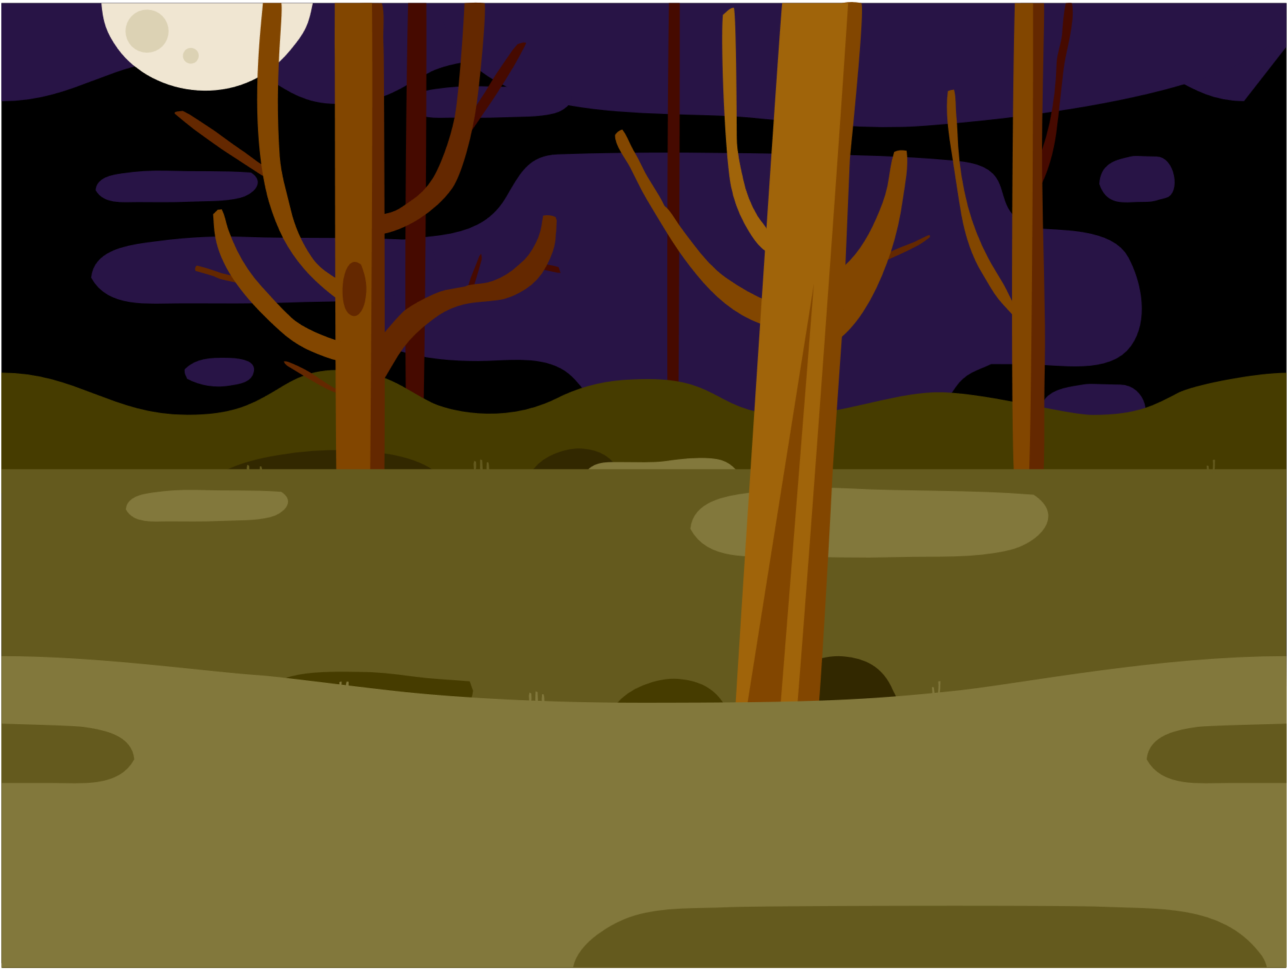
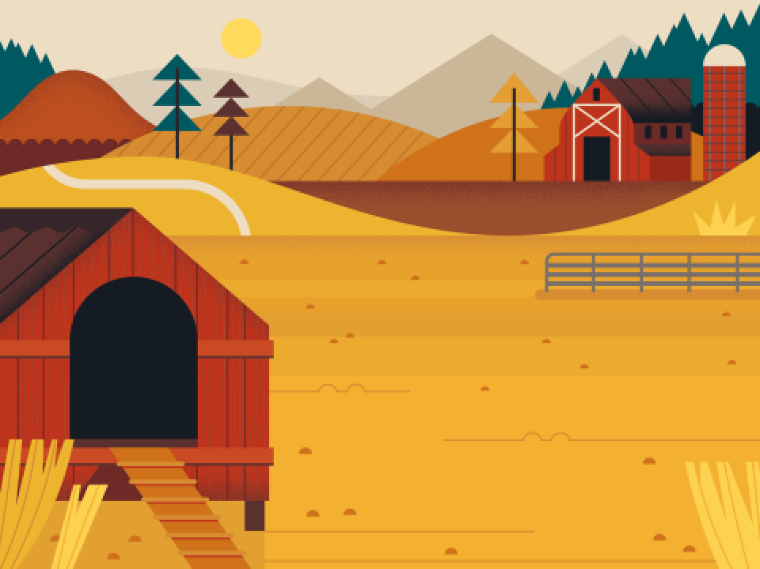
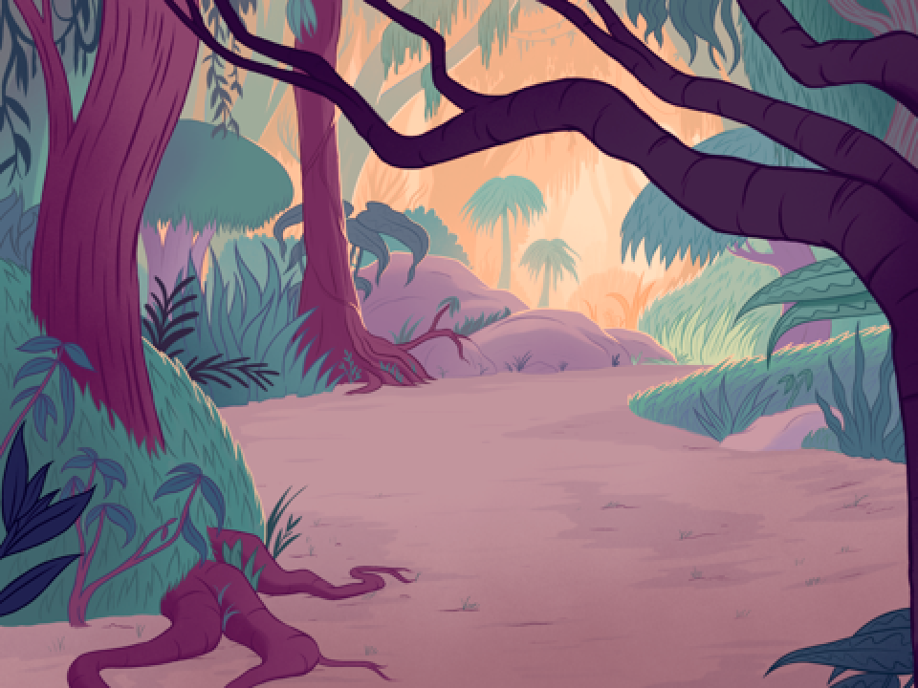
Three Levels
1st Level: Woods
2nd Level: Farm
3rd Level: Jungle
Each is a different Backdrop of the Stage

Slide 4
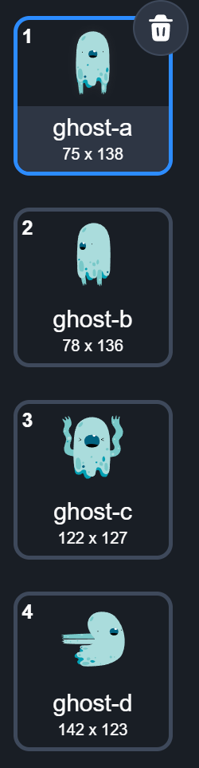
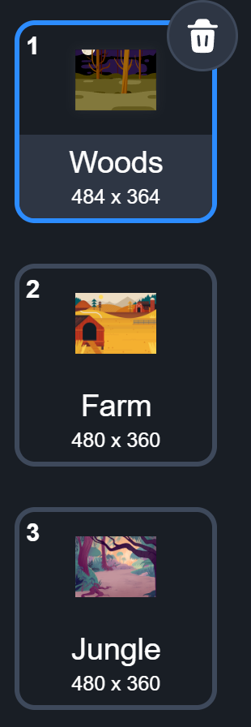
Backdrops Are Stage’s Costumes
Sprite has costumes
Stage has backdrops

Slide 5
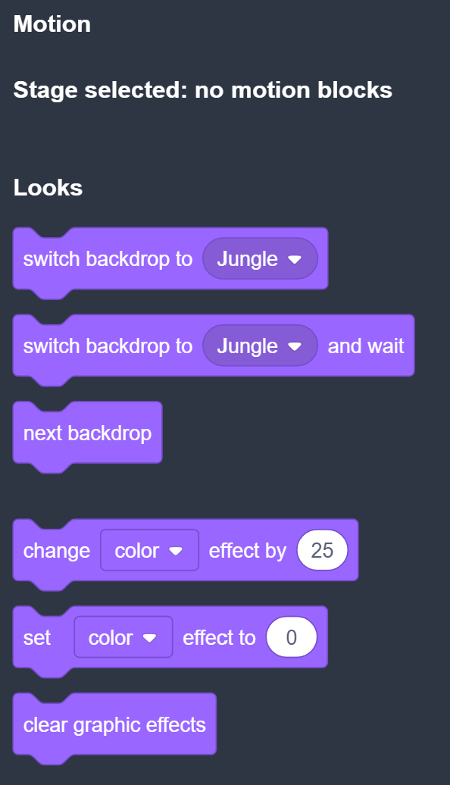
Code Blocks For Stage
No Motion blocks for Stage. Well, you don’t want to move the Stage anyway!

Slide 6
Change Backdrop For Stage
Look familiar?

Slide 7




Change Backdrop For Stage
Sprites
Stage
Stage is a special sprite

Slide 8
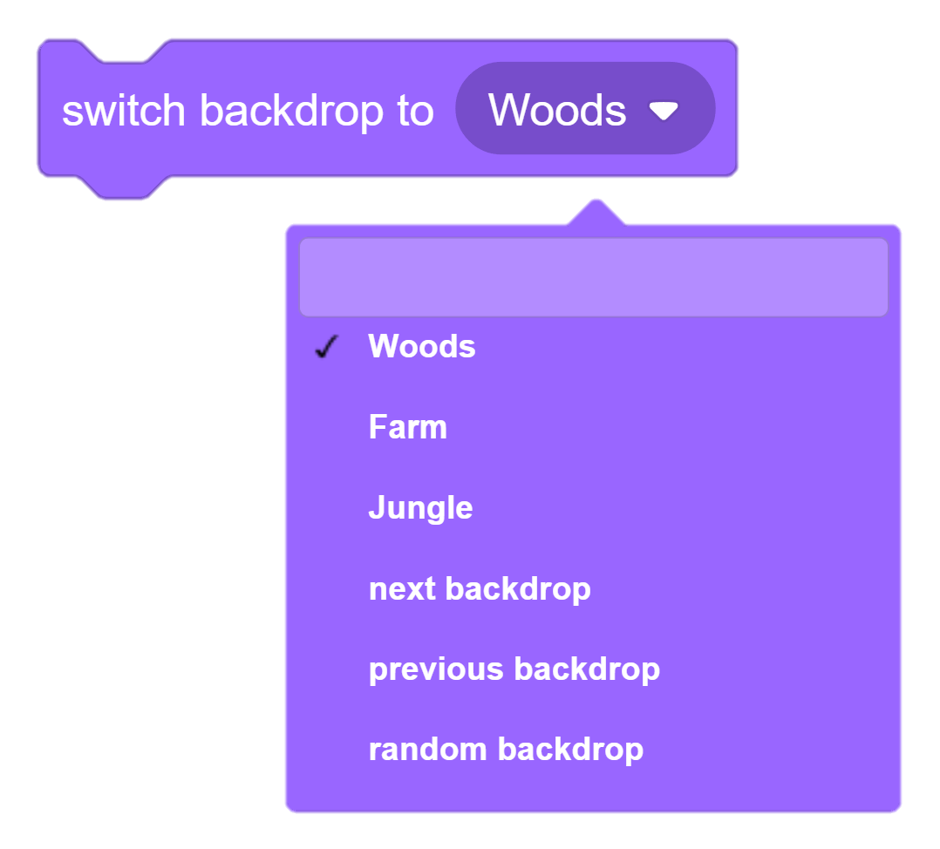
Change Backdrop For Stage

Slide 9
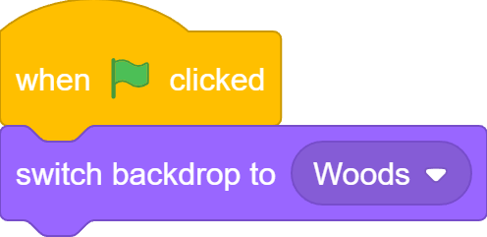
Start with Level1

Slide 10
Rename Backdrops
Woods → Level1
Farm → Level2
Jungle → Level3

Slide 11

What we learnt…
How to change sprite size using block

Slide 12
Exercises
How can you make the ghost fade out/in faster/slower?
Explore with other graphic effects and see what each one

Slide 13
Thank you and see you in the next lesson!

